Slide 1
Data Structures

Slide 2
Print elements at a particular level
Given any level, print all elements at that level in the tree.

Slide 3
Traversals – BFS - Recursive

Slide 4
Traversals – BFS – Iterative

Slide 5
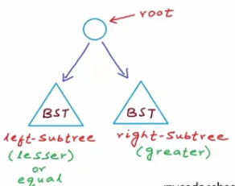
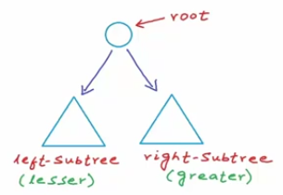
Binary Search Tree
A binary tree in which for each node, value of all the nodes in left subtree is lesser(or equal) and value of all the nodes in right subtree Is greater than the value of that node

Slide 6
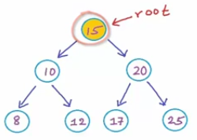
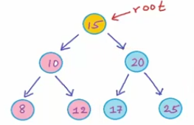
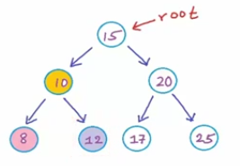
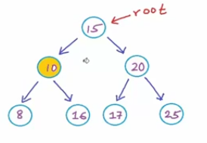
Which of these are BST’s?
1.
2.
No, Not a BST

Slide 7

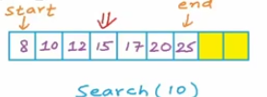
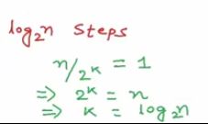
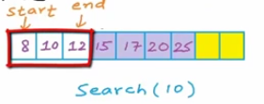
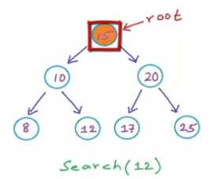
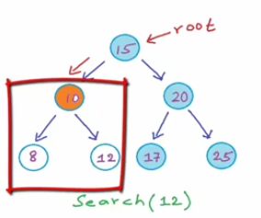
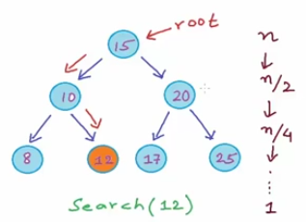
Searching an element in BST
For better understanding, we first see how to search an element in BST before we see how to insert an element.
In Binary Search:
Similarly in Binary Search Tree:
Balanced

Slide 8
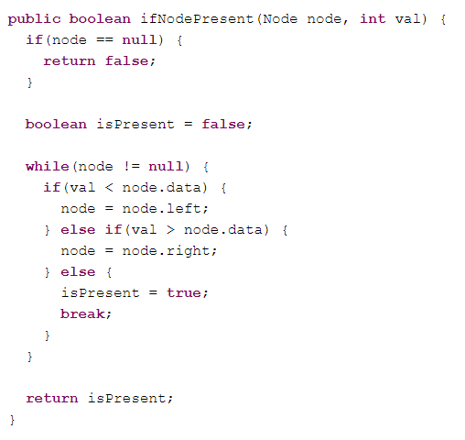
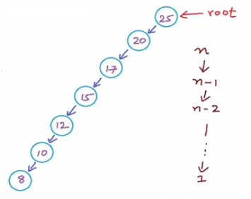
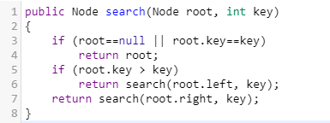
Searching an element in BST
So basically, in a BST we start at root and we compare the value at the root with the value to be searched, if its equal we’re done with the search. If the value is lesser then we will search in the left sub tree (due to the properties of BST), and if the value is greater then we will search in the right sub tree. At each step we discard one sub tree.

Slide 9
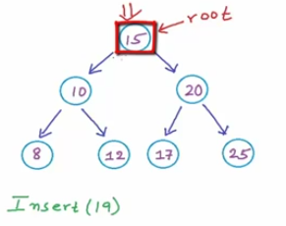
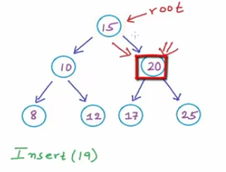
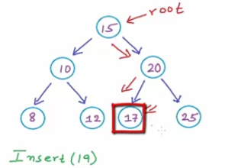
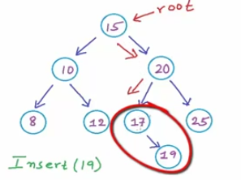
Inserting an element in BST
We will first find the position at which we have to insert. Hence O(log(n)) time
If the value to be inserted is lesser or equal then if there is no left child then insert as left child or go left.
If the value to be inserted is greater then if there is no right child then insert as right child or go right.
As creating a link takes constant time, so overall insertion also costs us like search.

Slide 10
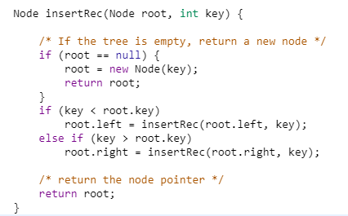
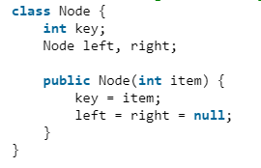

Slide 11
Finding min and max element in BST

Slide 12
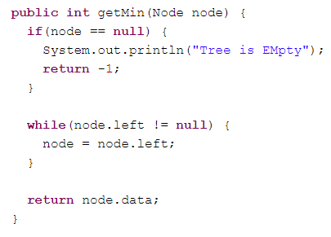
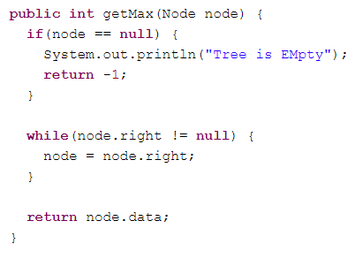
Finding min and max element in BST
Minimum
Maximum

Slide 13
Delete a Node from BST
Cases:
Deleting the leaf.
Deleting a node with one child.
Deleting a node with 2 children.

Slide 14
Delete a Node from BST
Deleting a node with 2 children.

Slide 15
Lowest Common Ancestor in a Binary Tree

Slide 16
Lowest Common Ancestor in a BST

Slide 17
THANK YOU

